Slide 1

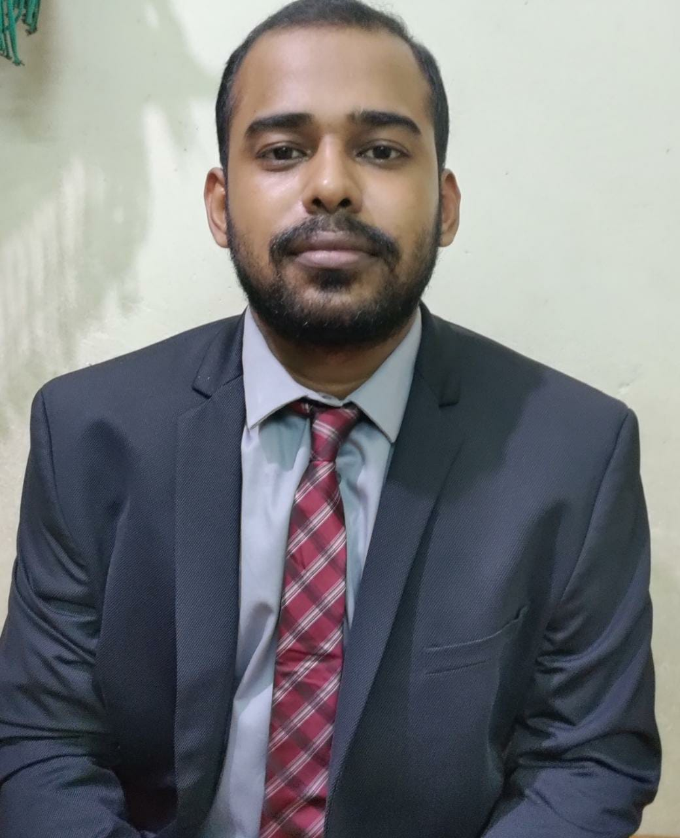
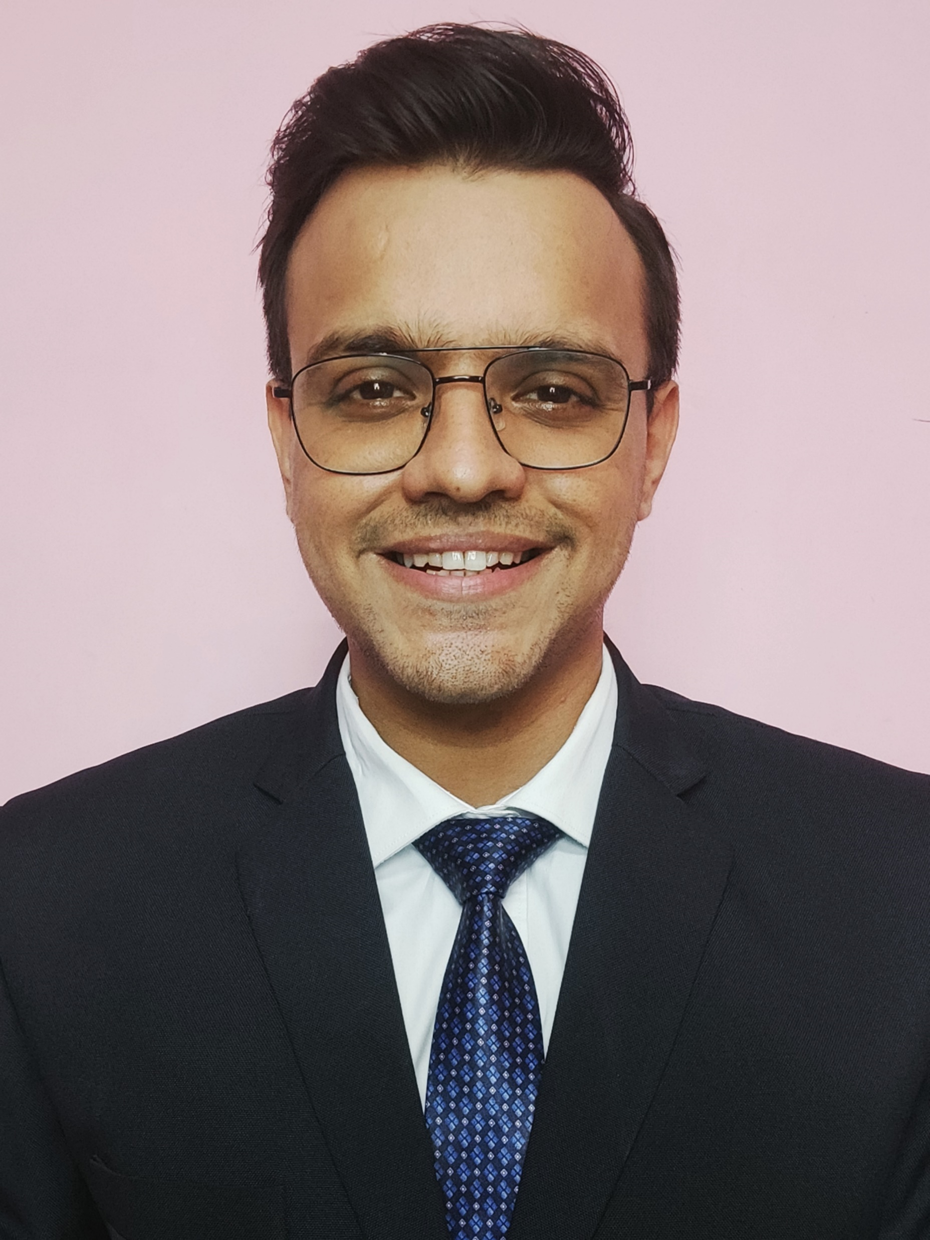

From Chaos to Success:
A case study on Change Management
Team SORTED
Devesh Sinha Mohit Kiradoo Kajal Gupta
T. A. Pai Management Institute

Slide 2



The Chaos
Creating the climate
Enabling & Implementing
Embedding the change
Vision: Providing guests with a comfortable and enjoyable stay
Popular choice among travellers:
Location Advantage: The hotel is located in the heart of the city, providing location advantage, hence has the capability to attract higher footfalls
Pricing: Prices are reasonable and affordable in spite of its prime location
Rosewood Hotel
The Pain Point
Struggled to consistently deliver a high level of service and guest satisfaction, failing to attain its stated vision
The Change
Change in ownership of the hotel, Mr Smith, the new owner
Vision: to modernize the hotel, adopting same standards as the other hotels in the chain
How?: Implementation of new policies and procedures which included a new reservation system, loyalty program and training for all staff members
New Reservation System
New Loyalty Program
The Chaos
Many staff members not used to, struggled to navigate, confusion amongst staff
Program perceived to be complex and time-consuming; resistance from staff members
The consequential impact: Longer waiting time and frustration among the guests
Corrective measures
Meetings to explain the new policies and procedures in detail
Written materials and additional training
The resistance received has more of psychological aspects which has lead to decrease in employee morale. Hence, it is imperative to build a positive workplace environment with vision aligned implementation process to calm the commotion.

Slide 3





The Chaos
Creating the climate
Enabling & Implementing
Embedding the change
Stakeholder Identification
(These would be the change agents influencing others in the organization)
Maria, General Manager
20 years workex, strong background in operations and ability to lead team successfully
John, Front Desk Manager
Working for the past 10 years, rose through the hierarchy, respected by his team, known for friendliness
Sarah, Housekeeping Manager
Working for the past 7 years, strong background in housekeeping, known for maintaining cleanliness and guest satisfaction
Promoters or stakeholders
in support of the change being implemented
Implementing Kotter’s Change Management Model to ease the commotion
Creating the climate for change
Create the urgency
To address or create the urgency of the situation, the following is recommended:
Sending data about guest dissatisfaction to staffs, repeated complaints received and feedbacks from repeat guests
Engaging in conversations about unsatisfactory service, unhappy customers and disgruntled shareholders
Honest discussions of the problems in company newspapers and senior management forums or speeches
Building the guiding team
Identifying the change agents on the basis of:
Position Power: Bring key people on board(main line managers), to reduce resistance from others not directly involved
Expertise: For bringing in varied, informed and intelligent decisions
Leadership: Proven leaders as change agents to drive the change implementation process
Based on these criterions, Maria, the General Manager, John, the Front Desk Manager and Sarah, the Housekeeping Manager are to be the change agents. Maria will take account of the overall policy and procedure implementation, John will take account of the issues faced in implementation of the new reservation system and Sarah, will take account of procedures to improve guest satisfaction. Maria will be the reporting manager for both John and Sarah. Stakeholders in support will act as key influencers.
Aligning with the vision
Communicating a clear picture of how the policies and procedures which are under implementation will increase the staff efficiency and increase the guest satisfaction which will be beneficial in long term to all stakeholders in the organization

Slide 4
The Chaos
Creating the climate
Enabling & Implementing
Embedding the change
Engaging & enabling the whole organization
Communicate for buy-in
Communicating the vision through all channels: daily meetings, formal and informal discussion forums, newspapers, internal groups of daily communication(WhatsApp/Mail) and also engaging the staff members promoting for the change to bring in members against through conversations
Engaging in a two-way communication, with the resistors of change to understand their problems and communicating how the hotel is looking forward to address the issues
Activities promoting repetition of the idea of implementation to be conducted, thus creating a verbal image of the future.
Empower action
Front office team to be tasked to train the staffs for the new reservation system by creating a dummy reservation portal, and gather feedback to address the problems or issues while working (On-the-job and off-the job training)
Sales team training to be conducted to communicate the changes in the loyalty program and articulate a story or pitch accordingly to why the changes have been brought in, thus enhancing the transparency attribute of the hotel amongst customers
Establish a customer complaint handling system to address guest complaints and communicate to the internal team through internal channels(WhatsApp Groups) and empower guest relation executives to engage in conversations with guests and collect verbal feedbacks
Create short-term wins
Use of as many numbers as possible, as this is the most visible aspect to see how the change has benefitted the stakeholders. Use of various KPI metrics(booking time or waiting time, etc) to show how the employee efficiency will increase through the dummy reservation portal
Create short term goals: # of positive feedbacks received, # of new customers added or rate of renewals on the loyalty program, increase in the # of reservations post and pre implementation, reduction in reservation time, reduction in customer churn, etc
Highlight feedbacks from guests who have given positive reviews about the new procedures and think their issues would be addressed on its implementation
Implement & sustain change
Build on the change
Perform lessons learned analysis after each stage of implementation and incorporate them into the next stage of implementation to build the momentum gained
Rewards, recognition and positive reviews will boost employee morale and motivation. Promotion of these staffs will help execute the implementation program, and act as tangible benefits to others in the organization
Use these as proven results and tangible benefits to increase the number of influential change agents. This will help turn neutral people to supports and reluctant ones to active helpers, thus bringing in more change influencers
Use the expanded group of change influencers to reinforce the momentum and boost the execution of the implementation process

Slide 5
The Chaos
Creating the climate
Enabling & Implementing
Embedding the change
Implement & sustain change
Embed the change
Identify how these approaches have helped build a positive culture in the workplace and how they are superior to the traditional or old methods
Use the established formal channels of communication to proclaim the success of the changes happening. Include stories of what was the situation earlier and how it is gradually taking a turn, all because of the employees or staff members working in the organization
Spread the word, by engaging in verbal communication and instruction to admit the validity of the new practices and procedures amongst the staff members, through the daily meetings or forums being held. Change agents to act as key anchors
Buy in the new hires or leaders in the organization to the new vision through these stories of change narrating a collaborative work environment
A recommended Customer Handling System to be implemented to address the customer complaints
Complaining Flow
Resolution Flow
Complaint from Customer
Complaint from Customer
Receipt/Ticket raised
Customer Satisfaction
Complain logged and tracking details issued
Customer
unhappy
Complaints management department
Complaints management department
Customer
happy(Closed)
Responsible department for investigation
Resolution/Ticket closed

